Slide 1
Amazon Prime Movies & TV Shows Data Warehouse Project
Hanqi Deng

Slide 2
Agenda
Datasets
Design
ETL
5 Business Questions
Tableau Visualization
References
Q & A

Slide 3
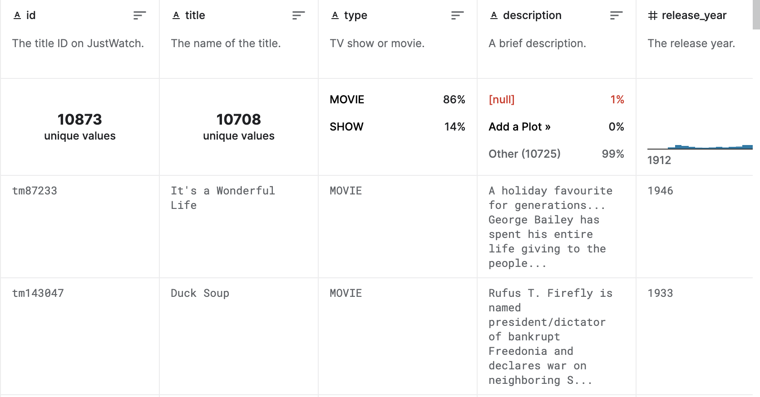
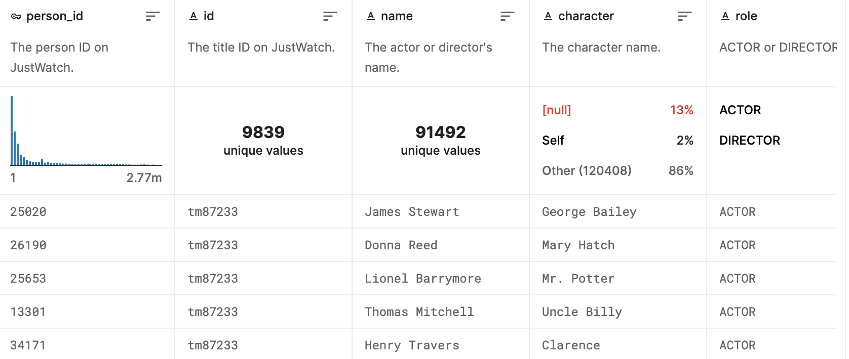
Datasets
Kaggle
Amazon prime movies/TV shows
Titles.csv: 10,873 rows * 15 columns
Credits.csv; 140,553 rows * 5 columns
Handling NaN values
Transforming lists

Slide 4
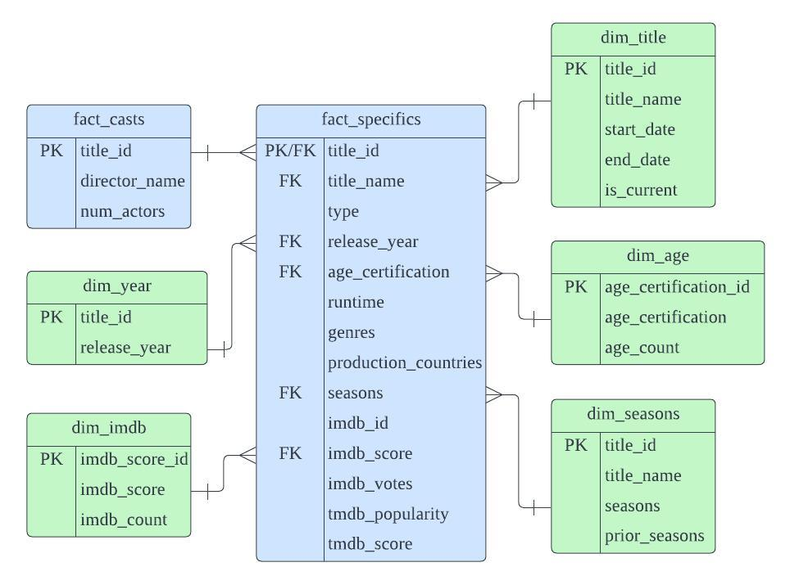
Design

Slide 5
ETL
2 fact tables: fact_specifics (snapshot), fact_casts(cumulative)
5 dimension tables: dim_year(SCD 0), dim_imdb(SCD 1), dim_title(SCD 2), dim_age(SCD 1), dim_seasons(SCD 3)

Slide 6
5 Business Questions
Does release year impact imdb score? Do older movies/TV shows get higher scores?
What age certification types are there? What types are the majority?
How is the number of seasons for TV shows ranked? What is the TV show with the largest number of seasons?
Does imdb score follow a normal distribution?
For movies/TV shows with only one production country, what genres does each country produce and what are the counts?

Slide 7
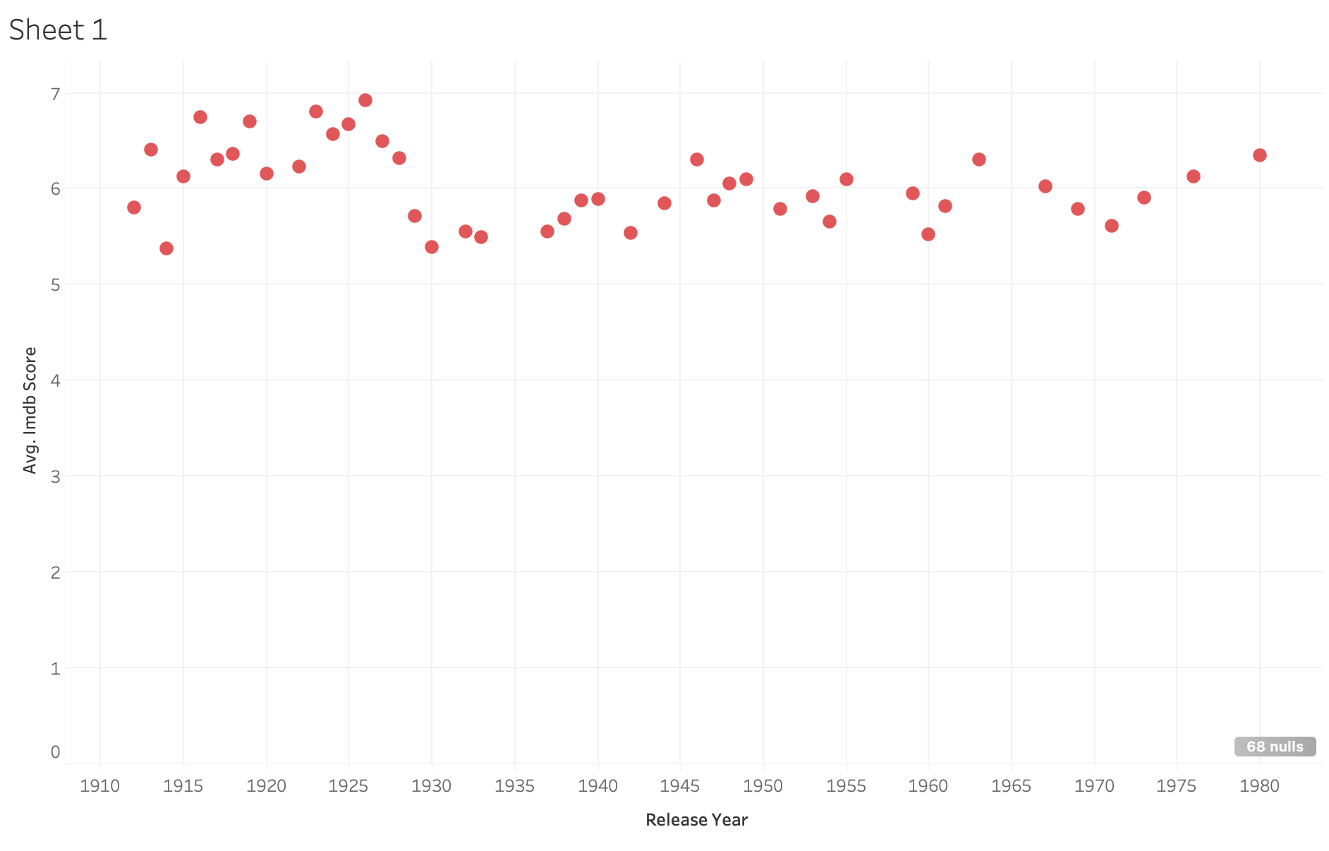
1.Does release year impact imdb score? Do older movies/TV shows get higher scores?

Slide 8
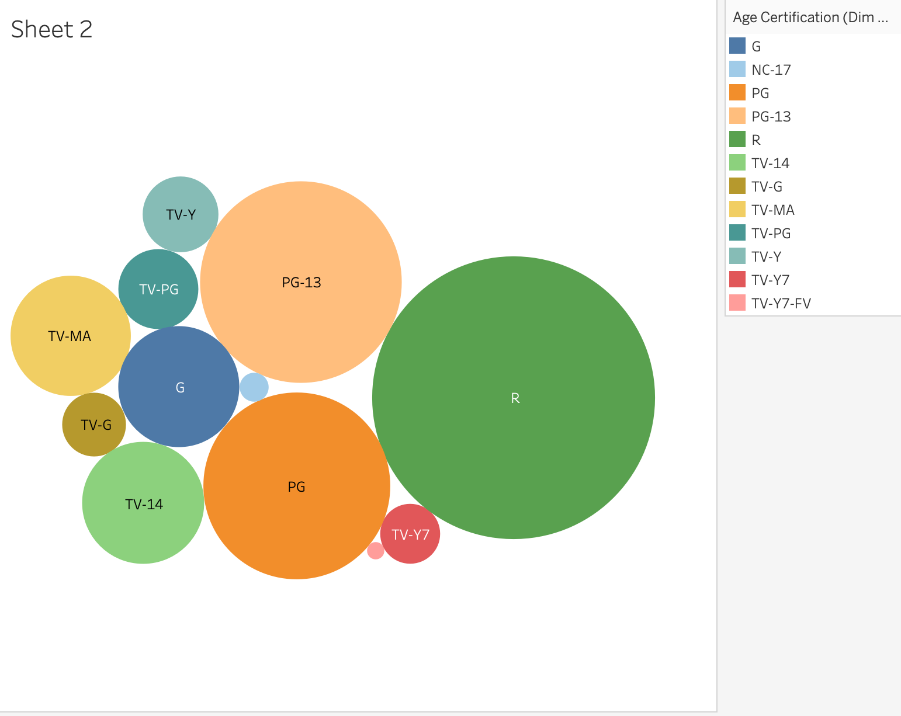
2. What age certification types are there? What types are the majority?

Slide 9
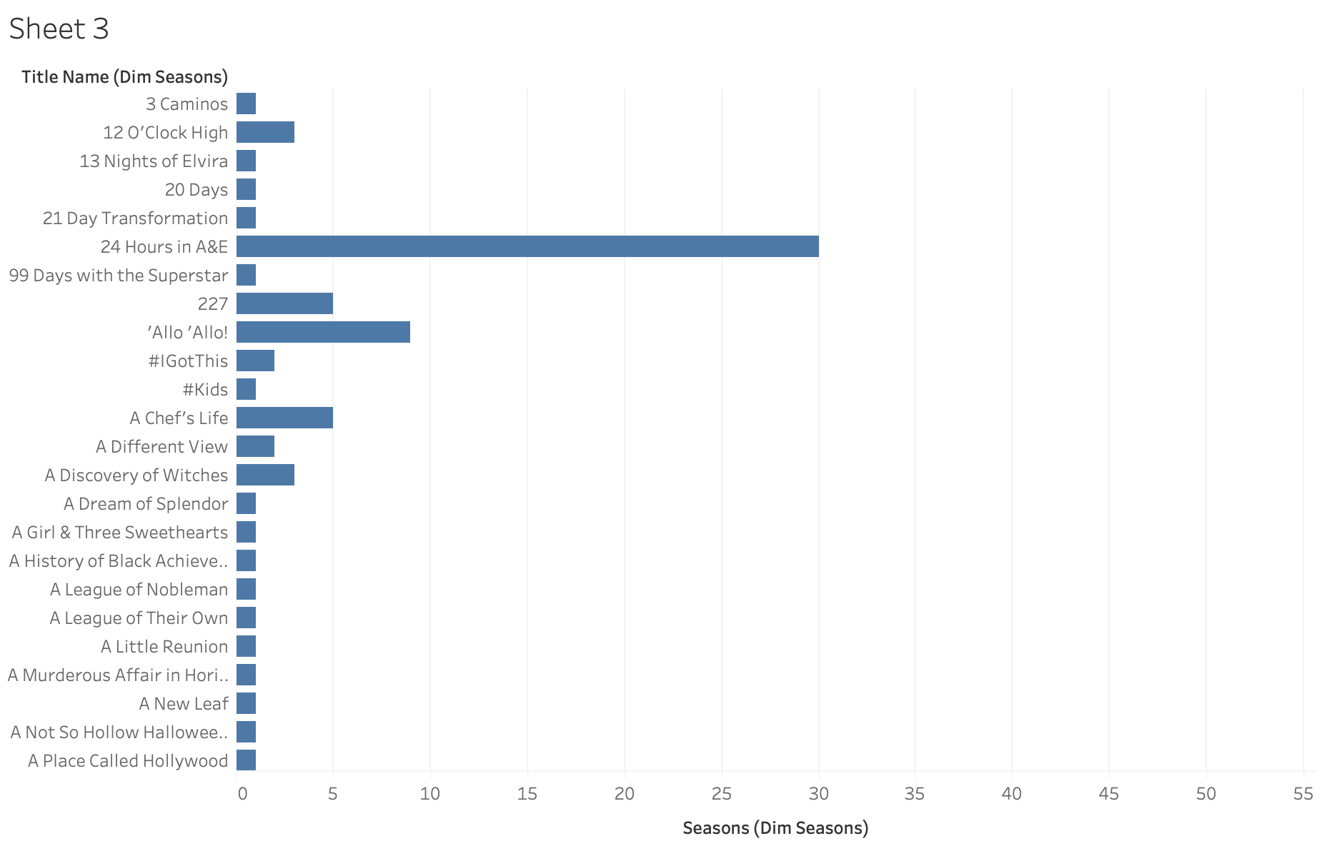
3. How is the number of seasons for TV shows ranked? What is the TV show with the largest number of seasons?

Slide 10
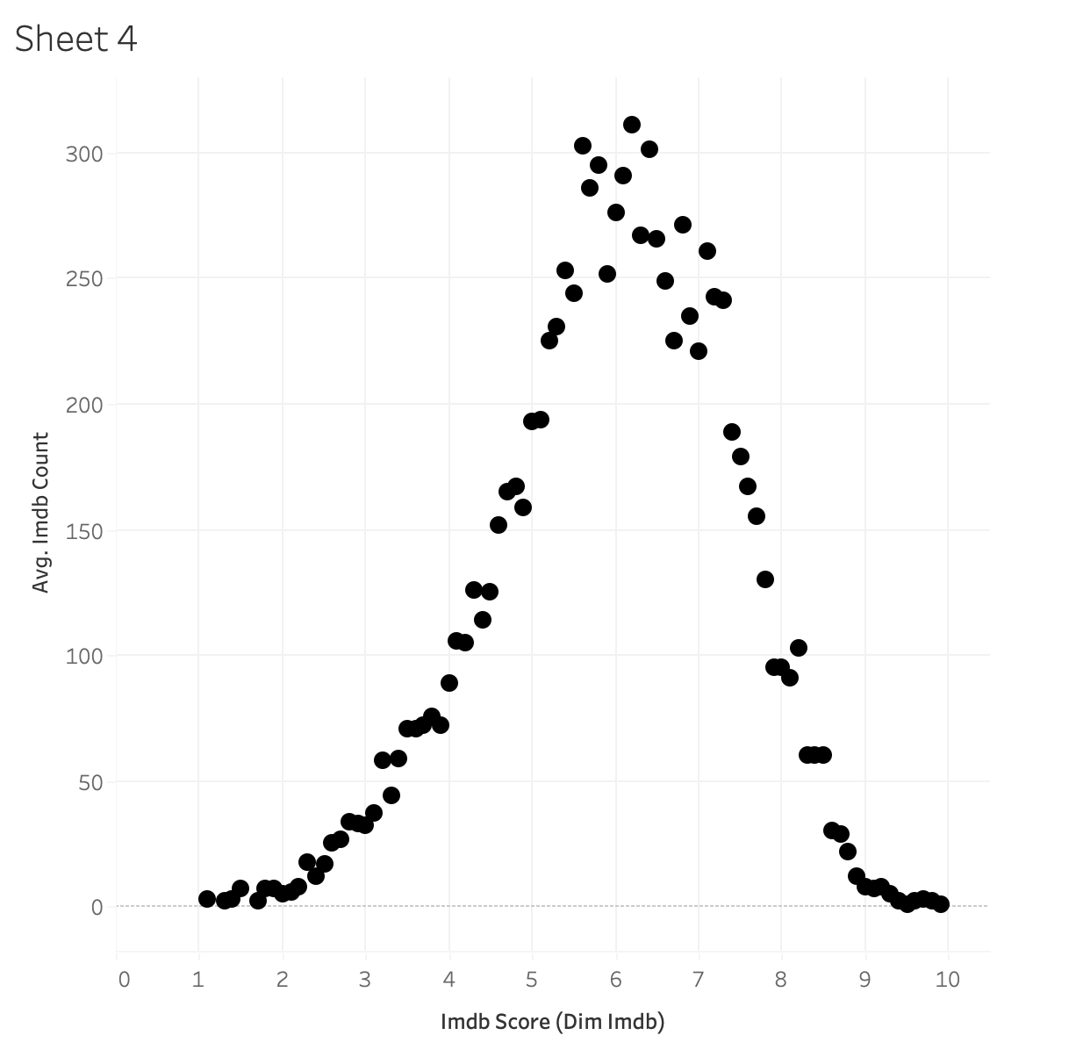
4.Does imdb score follow a normal distribution?

Slide 11
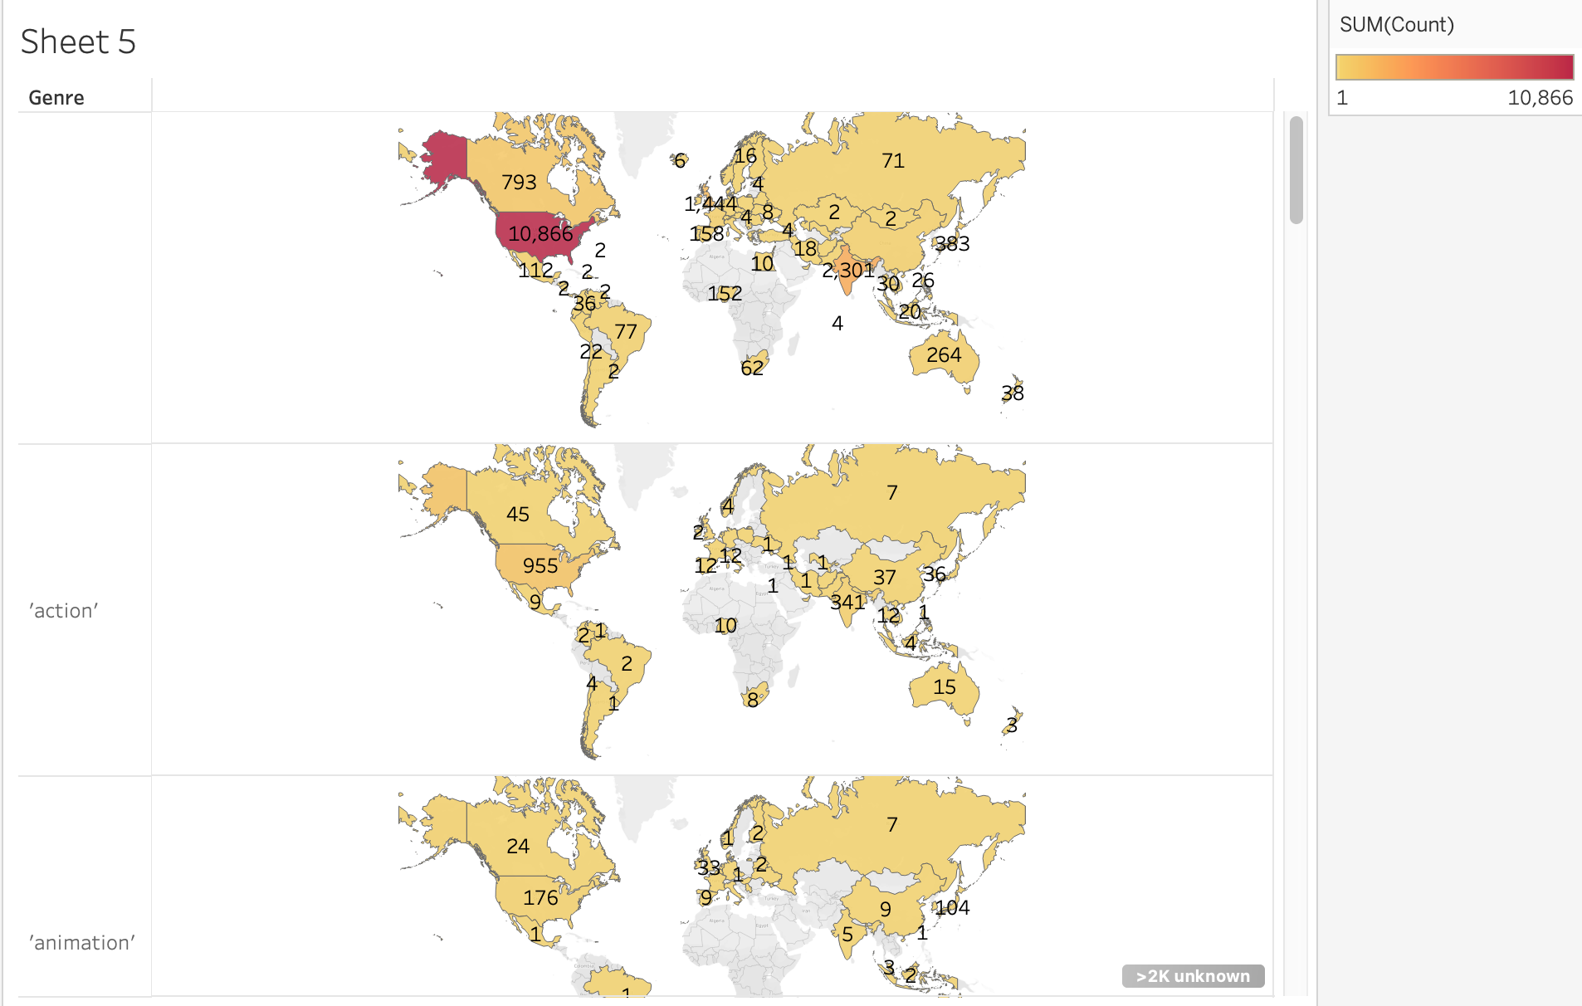
5.For movies/TV shows with only one production country, what genres does each country produce and what are the counts?

Slide 12
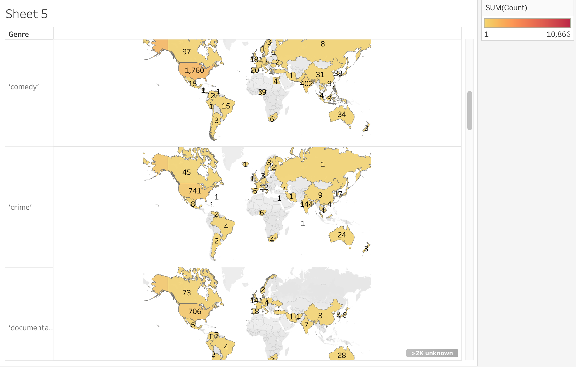

Slide 13
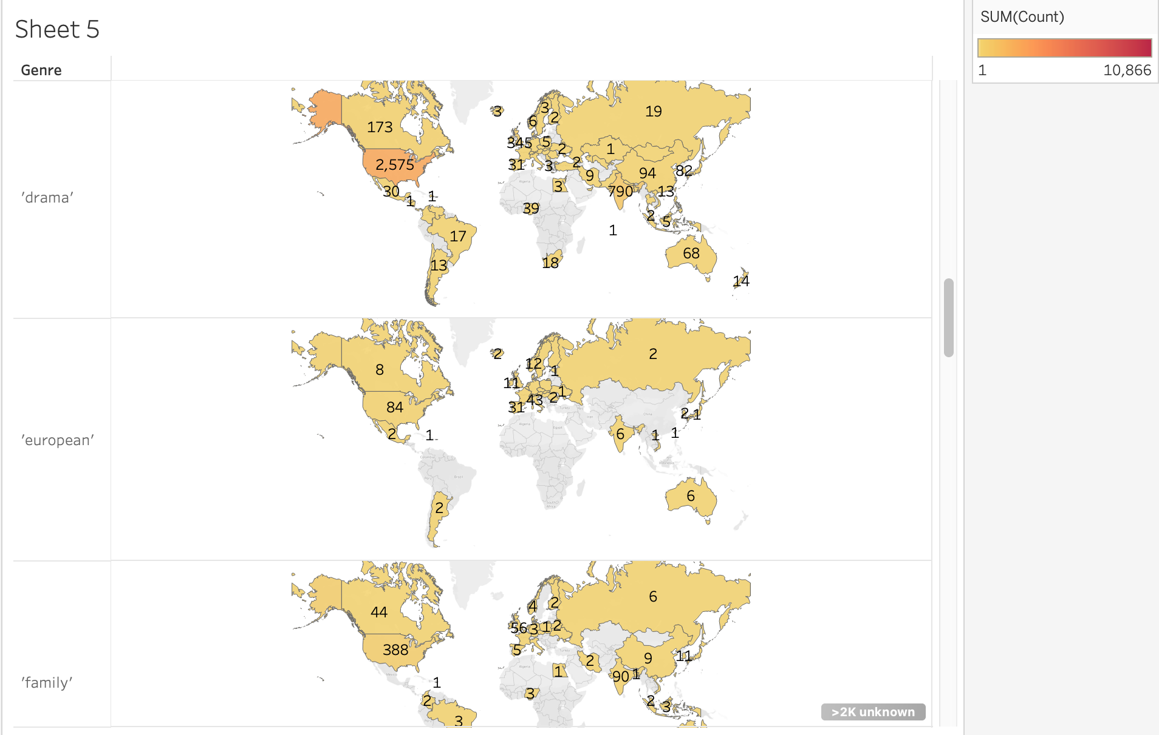

Slide 14
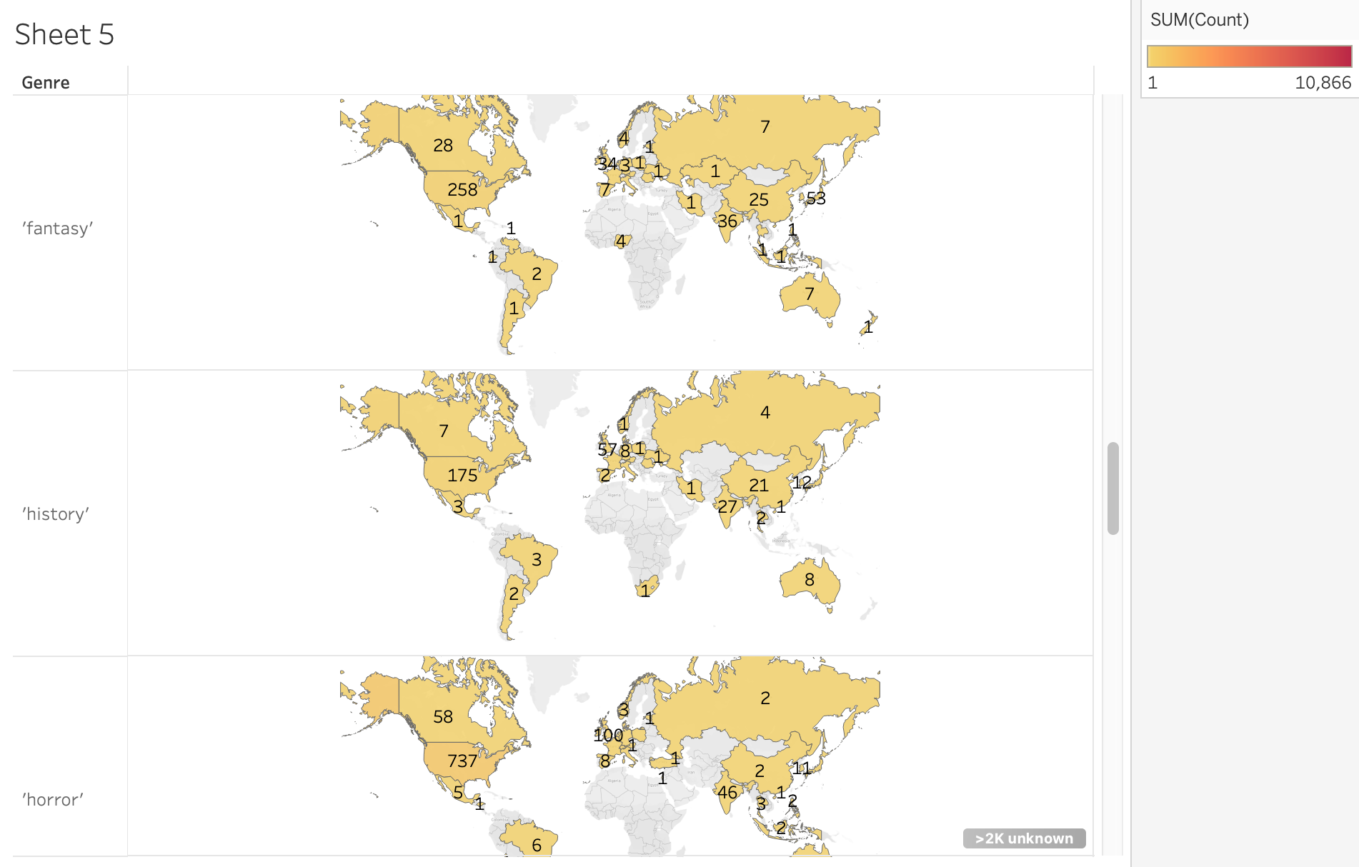

Slide 15
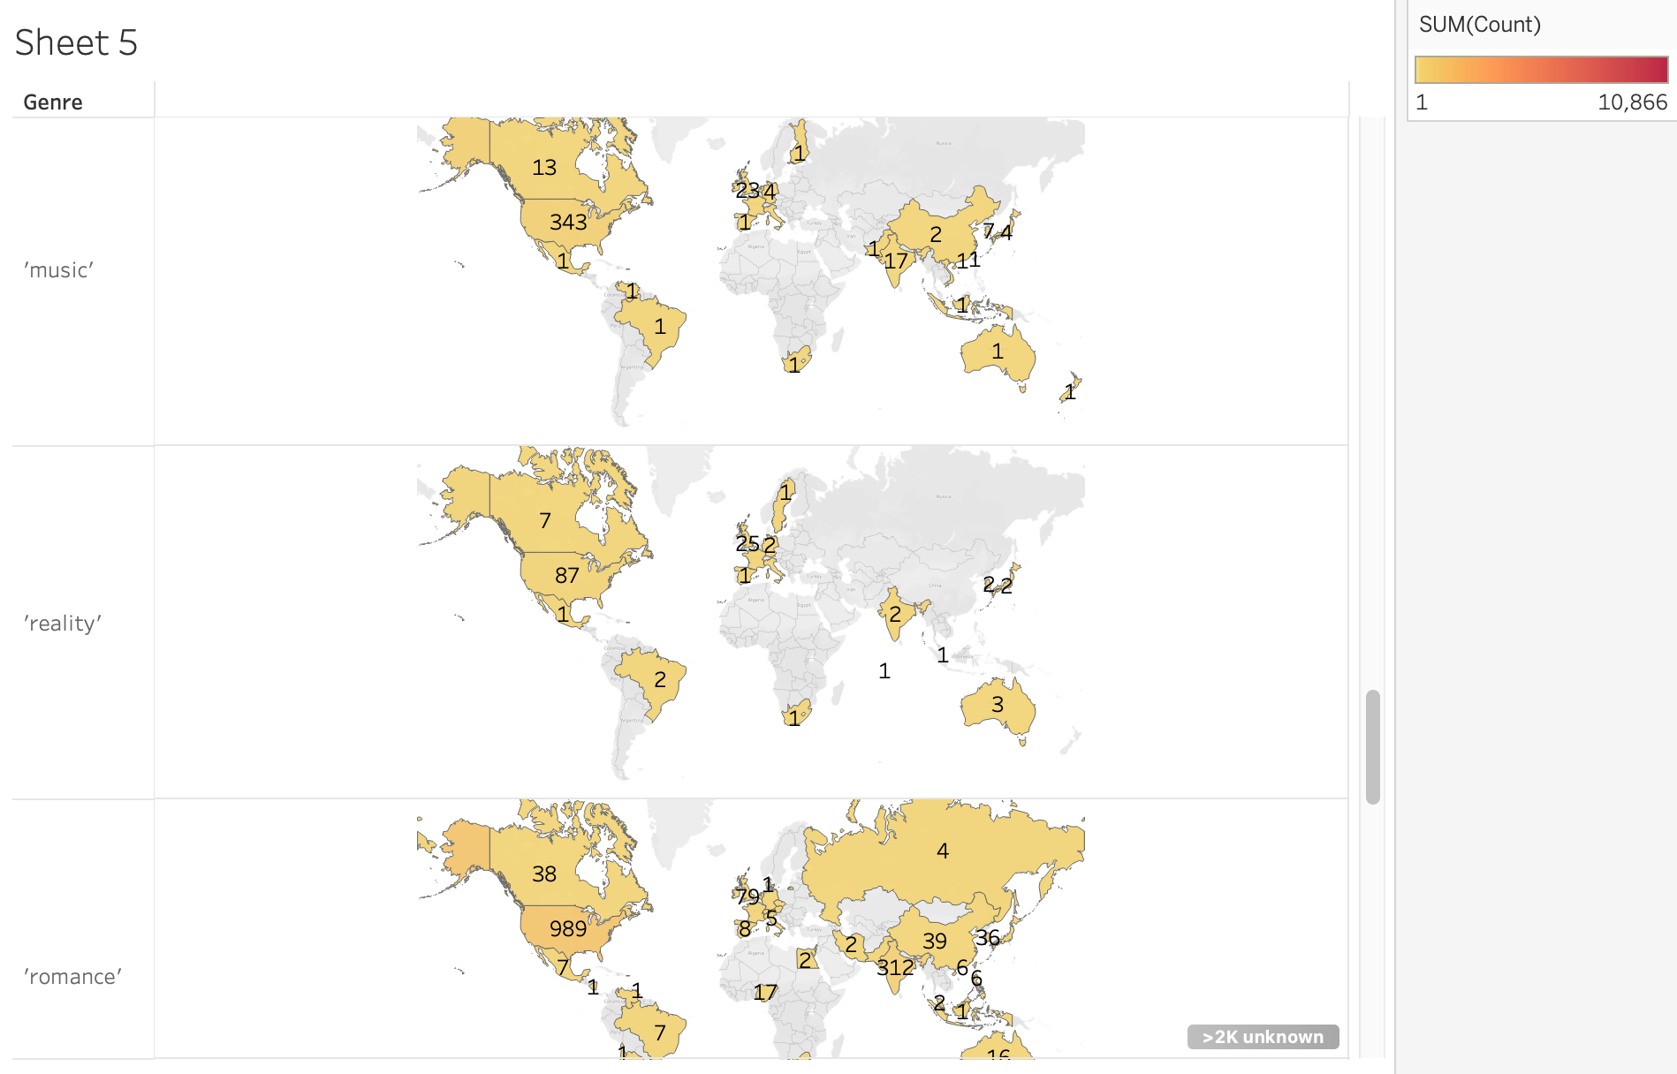

Slide 16
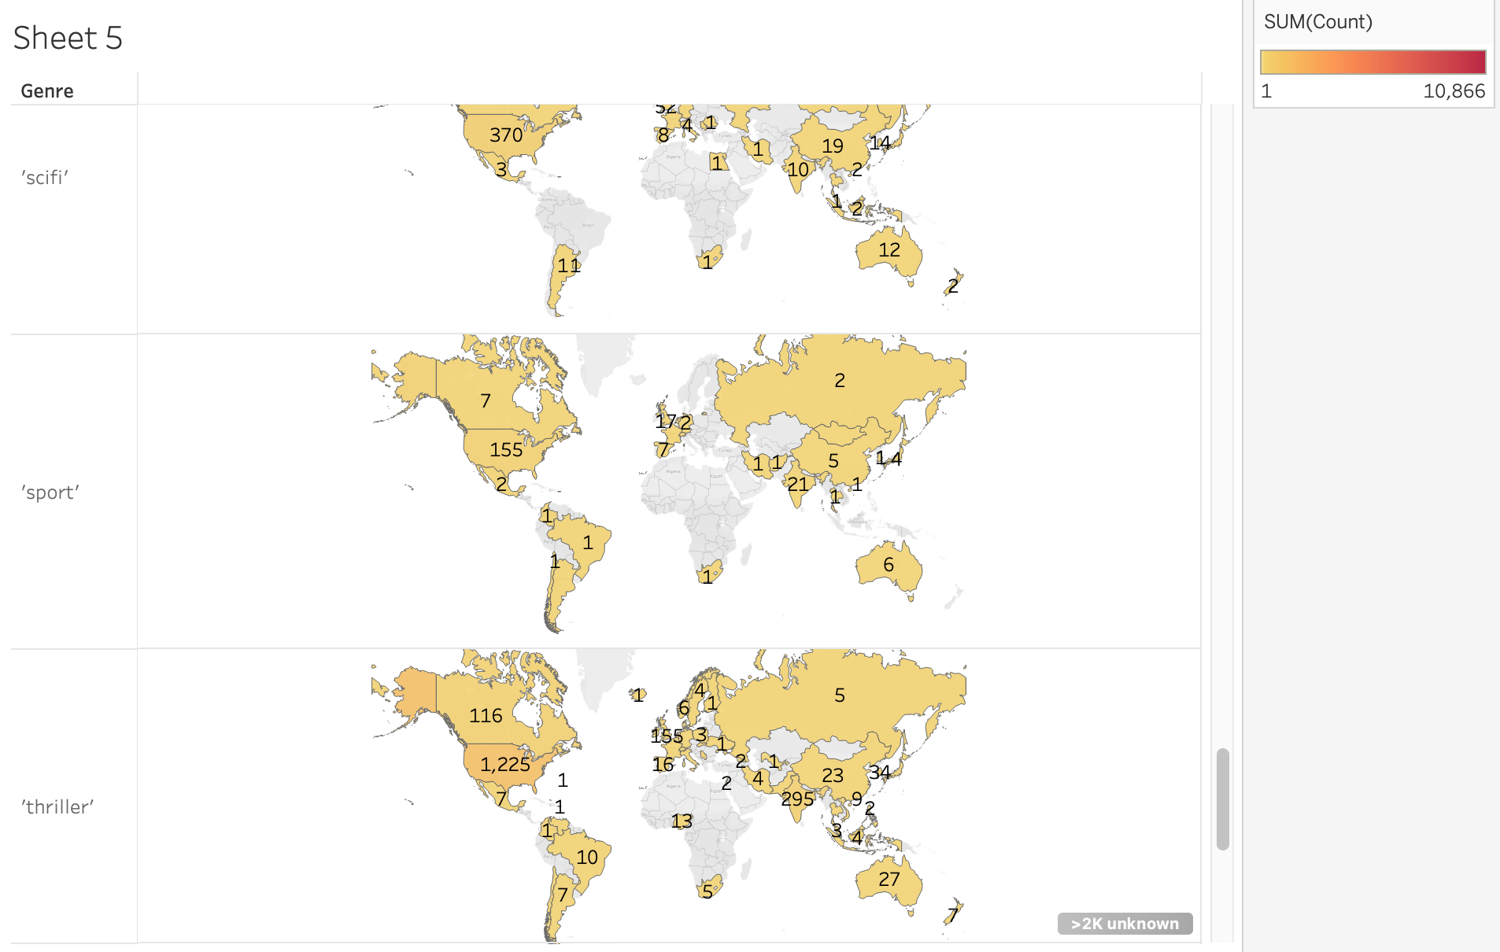

Slide 17
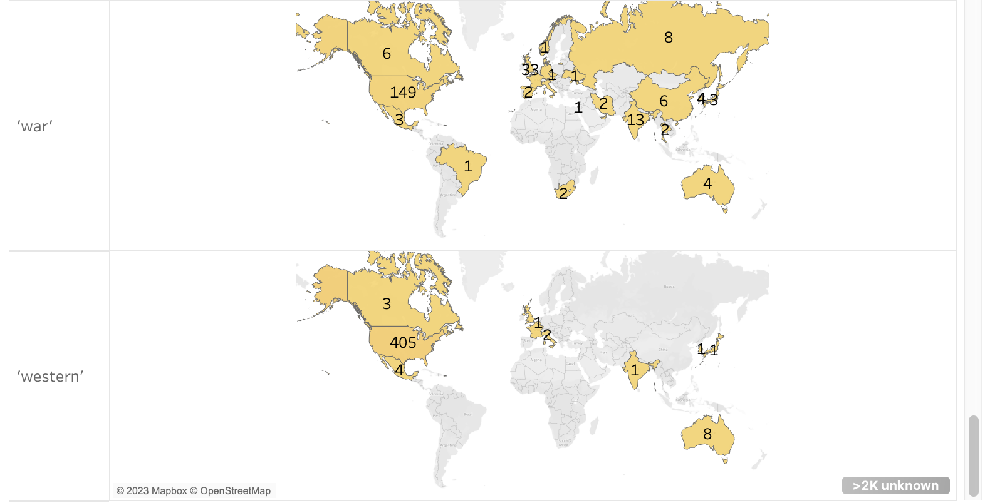

Slide 18
References
https://www.kaggle.com/datasets/dgoenrique/amazon-prime-movies-and-tv-shows?resource=download&select=titles.csv

Slide 19
Q & A

Slide 20
Thank you!

